Slide 1
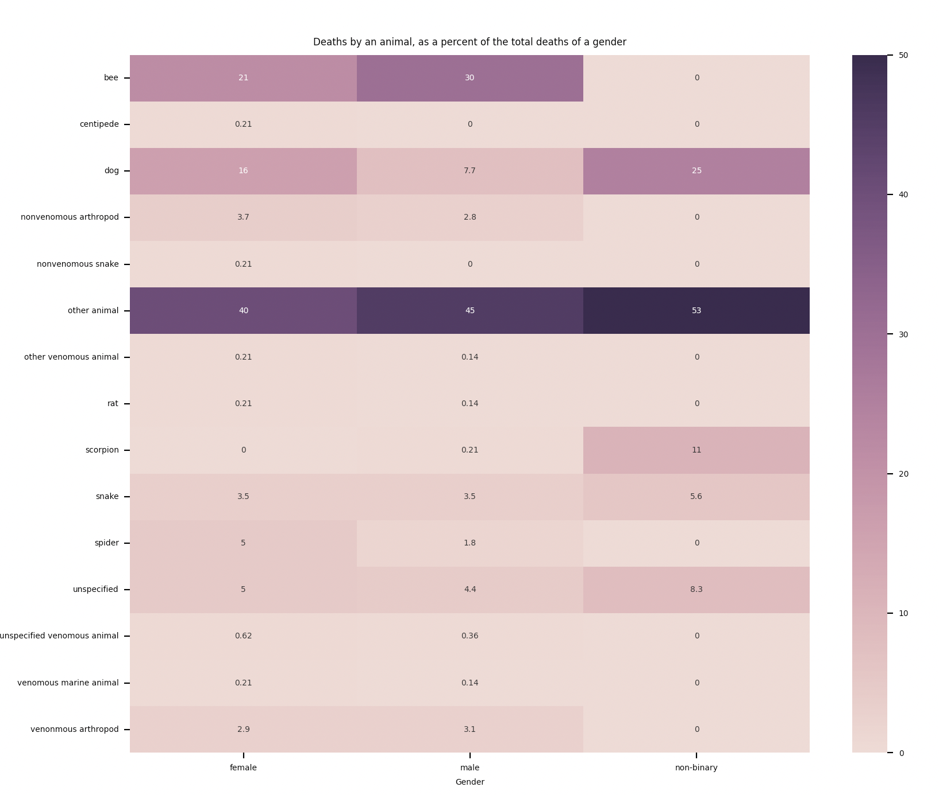
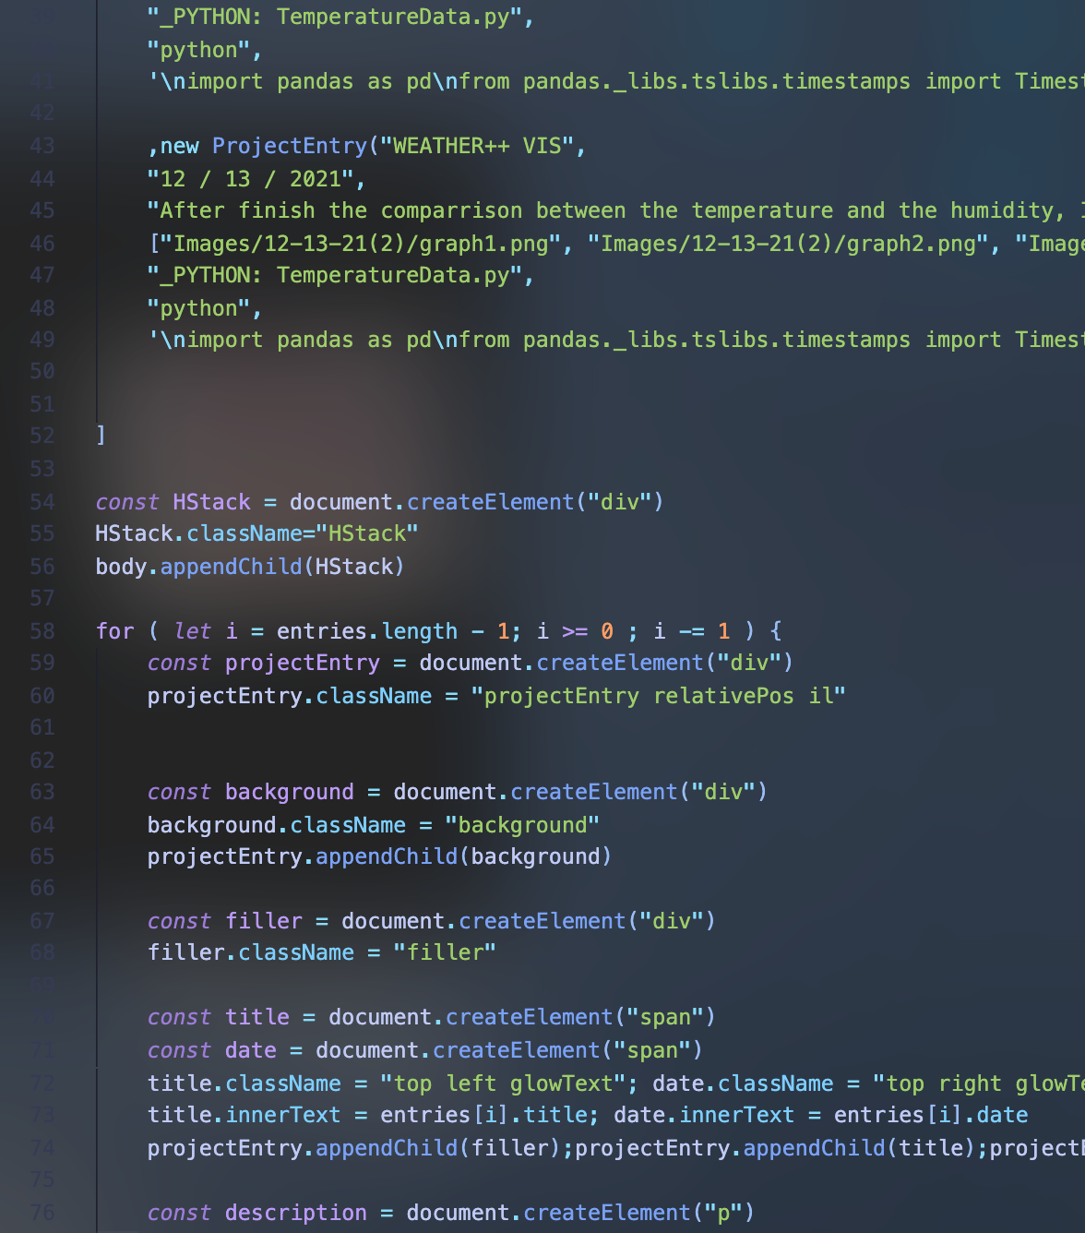
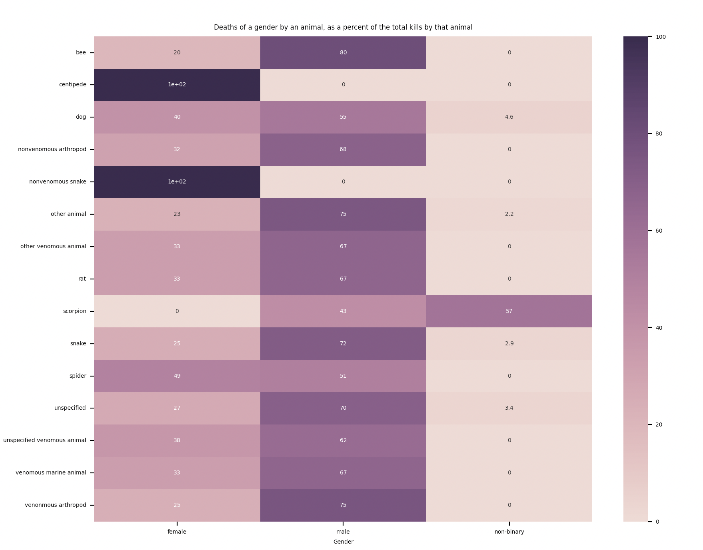
_ADDISON DATA SET VIS:
Visualizing the effects of date and time on temperature
_edit : _theme : _full Repo
12 – 5 - 21
GAL\ERY
~$test.py
:Visualizing the effects of date and time on temperature Visualizing the effects of date and time on temperature Visualizing the effects of date and time on temperature Visualizing the effects of date and time on temperature
Visualizing the effects of date and time on temperature Visualizing the effects of date and time on temperature
Visualizing the effects of date and time on temperature Visualizing the effects of date and time on temperature
Visualizing the effects of date and time on temperature Visualizing the effects of date and time on temperature

Slide 2
_ADDISON DATA SET VIS:
Visualizing the effects of date and time on temperature
[edit : theme : full Repo]
12 – 5 - 21
<GAL\ERY>
[download]
<Test.py>
[download]

Slide 3
_ADDISON DATA SET VIS:
_edit : _theme : _full Repo
Visualizing the effects of date and time on temperature
12 – 5 - 21
~$test.py

Slide 4
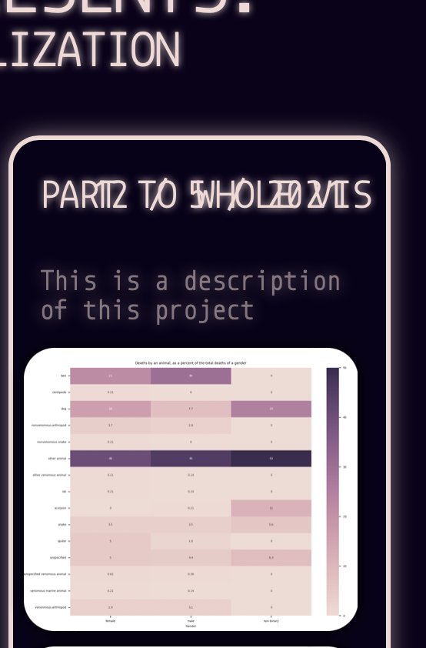
color

